Slide 1
Intel 8086

Slide 2
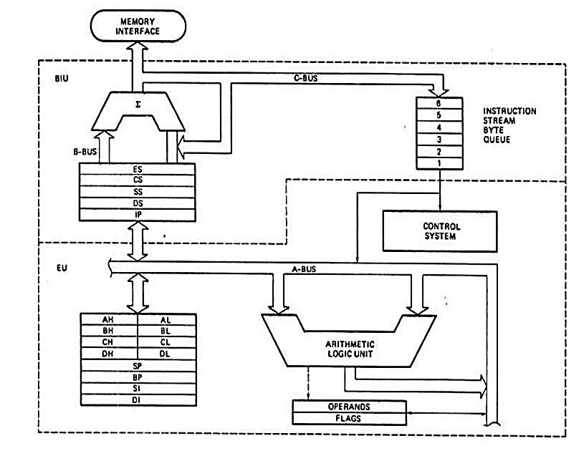

Slide 3
Features of 8086 microprocessor
Intel 8086 is a widely used 16 bit microprocessor.
The 8086 can directly address 1MB of memory.
The internal architecture of the 8086 microprocessor is an example of register based microprocessor and it uses segmented memory.
It pre-fetches up to 6 instruction bytes from the memory and queues them in order to speed up the instruction execution.
It has data bus of width 16 bits and address bus of width 20 bits. So it always accesses a 16 bit word to or from memory.
The 8086 microprocessor is divided internally into two separate units which are Bus interface unit (BIU) and the execution unit (EU).
The BIU fetches instructions, reads operands and write results.
The EU executes instructions that have already been fetched by BIU so that instructions fetch overlaps with execution.
A 16 bit ALU in the EU maintains the MP status and control flags, manipulates general register and instruction operands.

Slide 4
Bus Interface Unit(BIU) and its Components
The BIU sends out addresses, fetches instructions from memory reads data from memory or ports and writes data to memory or ports. So it handles all transfers of data and address on the buses for EU. It has main 2 parts: instruction queue and segment registers.
The BIU can store up to 6 bytes of instructions with FIFO (First in First Out) manner in a register set called a queue. When EU is ready for next instruction, it simply reads the instruction from the queue in the BIU. This is done in order to speed up program execution by overlapping instruction fetch with execution. This mechanism is known as pipelining.
The BIU contains a dedicated address, which is used to produce 20 bit address. Four segment registers in the BIU are used to hold the upper 16 bits of the starting address of four memory segments that the 8086 is working at a particular time. These are code segment, data segment, stack segment and extra segment. The 8086’s 1 MB memory is divided into segments up to 64KB each.

Slide 5
Code segment register and instruction pointer (IP): The CS contains the base or start of the current code segment. The IP contains the distance or offset from this address to the next instruction byte to be fetched. Code segment address plus an offset value in the IP indicates the address of an instruction to be fetched for execution.
Data Segment: Data segment Contains the starting address of a program’s data segment. Instructions use this address to locate data. This address plus an offset value in an instruction, causes a reference to a specific byte location in the data segment.

Slide 6
Stack segment (SS) and Stack Pointer (SP)
Stack segment Contains the starting address of a program’s stack segment. This segment address plus an offset value in the stack pointer indicates the current word in the stack being addressed.
Extra Segment(ES)
It is used by some string (character data) to handle memory addressing. The string instructions always use the ES and destination index (DI) to determine 20 bit physical address.
Execution Unit (EU)
The EU decodes and executes the instructions. The EU contains arithmetic and logic (ALU), a control unit, and a number of registers. These features provide for execution of instructions and arithmetic and logical operations. It has nine 16 bit registers which are AX, BX, CX, DX, SP, BP, SI, DI and flag. First four can be used as 8 bit register (AH, AL, BH, BL, CH, DH, DL)

Slide 7
-AX Register
AX register is called 16 bit accumulator and AL is called 8 bit accumulator. The I/O (IN or OUT) instructions always use the AX or AL for inputting/Outputting 16 or 8 bit data from or to I/O port.
- BX Register
BX is known as the base register since it is the only general purpose register that can be used as an index to extend addressing. The BX register is similar to the 8085’s H, L register. BX can also be combined with DI or SI as C base register for special addressing.
-CX register:
The CX register is known as the counter register because some instructions such as SHIFT, ROTATE and LOOP use the contents of CX as a Counter.

Slide 8
- DX register:
The DX register is known as data register. Some I/O operations require its use and multiply and divide operations that involve large values assume the use of DX and AX together as a pair. DX comprises the rightmost 16 bits of the 32-bit EDX.

Slide 9
-Stack Pointer (SP) and Base Pointer (BP):
Both are used to access data in the stack segment. The SP is used as an offset from the current stack segment during execution of instructions. The SP’s contents are automatically updated (increment/decrement) during execution of a POP and PUSH instructions.
The BP contains the offset address in the current stack segment. This offset is used by instructions utilizing the based addressing mode.
- Index register:
The two index registers SI (Source index) and DI (Destination Index) are used in indexed addressing. The instructions that process data strings use the SI and DI index register together with DS and ES respectively, in order to distinguish between the source and destination address.

Slide 10
-Flag register:
The 8086 has nine 1 bit flags. Out of 9 six are status and three are control flags. The control bits in the flag register can be set or reset by the programmer.
D15 | D14 | D13 | D12 | D11 | D10 | D9 | D8 | D7 | D6 | D5 | D4 | D3 | D2 | D1 | D0
 |  |  |  | O | D | I | T | S | Z |  | A |  | P |  | C

Slide 11
O- Overflow flag This flag is set if an arithmetic overflow occurs, i.e. if the result of a signed operation is large enough to be accommodated in a destination register.
D-Direction Flag This is used by string manipulation instructions. If this flag bit is ‘0’, the string is processed beginning from the lowest address to the higher address, i.e. auto incrementing mode otherwise the string is processed from the highest address towards the lowest address, i.e. auto decrementing mode.
I-Interrupt flag If this flag is set the maskable interrupts are recognized by the CPU, otherwise they are ignored.
T- Trap flag If this flag is set the processor enters the single step execution mode. In other words, a trap interrupt is generated after execution of each instruction. The processor executes the current instruction and the control is transferred to the Trap interrupt service routine.

Slide 12
S - Sign flag: This flag is set when the result of any computation is negative. For signed computations, the sign flag equals the MSB of the result.
Z- Zero This flag is set when the result of the computation is or comparison performed by the previous instruction is zero. 1 for zero result, 0 for nonzero result
A- Auxiliary Carry This is set if there is a carry from the lowest nibble, i.e. bit three during the addition or borrow for the lowest nibble i.e. bit three, during subtraction.
P- Parity flag This flag is set to 1 if the lower byte of the result contains even number of 1s otherwise reset.
C-Carry flag This flag is set when there is a carry out of MSB in case of addition or a borrow in case of subtraction.

Slide 13
SEGMENT AND OFFSET ADDRESS:
Segments are special areas defined in a program for containing the code, data and stack. A segment begins on a paragraph boundary. A segment register is of 16 bits in size and contains the starting address of a segment.
A segment begins on a paragraph boundary, which is an address divisible by decimal 16 or hex 10. Consider a DS that begins at location 038EOH. In all cases, the rightmost hex digit is zero, the computer designers decided that it would be unnecessary to store the zero the zero digit in the segment register. Thus 038E0H is stores in register as 038EH.
The distance in bytes from the segment address to another location within the segment is expressed as an offset or displacement. Suppose the offset of 0032H for above example of data segment. Processor combines the address of the data segment with the offset as:
SA: OA (segment address: offset address)
038E: 0032 H = 038E * 10 +0032 = 038E0 + 0032 Physical address = 03912H

Slide 14
Instructions in 8086
1) Arithmetic Instructions
a) ADD reg8 /mem8 , reg8/mem8/ Immediate8
ADD reg16/mem16 , reg16/ mem16/ Immediate16
E.g. ADD AH, 15 ; It adds binary number
ADD Al, [BX]
ADD [BX], CX
ADD AX, [BX]
b) ADC: Addition with Carry
ADC reg/ mem, reg/mem/Immediate data

Slide 15
c) SUB: Subtract 8 bit or 16 bit binary numbers
SUB reg/mem, reg/mem/Immediate
d) SBB: Subtract with borrow
SBB reg/mem, reg/mem/Immediate
e) MUL : unsigned multiplication
MUL reg8/mem8 (8 bit accumulator – AL)
MUL reg16/ mem16 (16 bit accumulator -AX)
E.g. MUL R8(multiplier) =R8*AL→ AX (16 bit result)
MUL R16(multiplier) =R16*AL → DX:AX (32 bit result)
IMUL – signed multiplication
Same operation as MUL but takes sign into account

Slide 16
f) DIV reg/mem
E.g. DIV R8 = AX/R8 (Remainder AH) & (Quotient AL)
DIV R16 = DX:AX/R16 (Remainder DX) & (Quotient AX)
IDIV- Signed division
Same operation as DIV but takes sign into account.
g) INC/DEC (Increment/Decrement by 1)
INC/DEC reg./mem. (8 bit or 16bit)
E.g. INC AL
DEC BX

Slide 17
h) NEG- Negate (2’s complement)
i) ASCII-BCD Conversion
AAA: ASCII Adjust after addition
AAS: ASCII Adjust after subtraction
AAM: Adjust after multiplication
AAD: Adjust after division
DAA: Decimal adjust after addition
DAS: Decimal adjust after subtraction

Slide 18
2) Logical/shifting/comparison instructions
a) Logical
AND/OR/XOR reg/mem, reg/mem/immediate
NOT reg/mem
E.g. AND AL, AH
XOR [BX], CL
b) Rotation
ROL- rotate left, ROR-rotate right
E.g. ROL AX, 1 ; rotated by 1
ROL AX, CL ; if we need to rotate more than one bit
RCL-rotate left through carry
RCR-rotate right through carry
E.g. RCL AX, 1
RCL AX, CL ; Only CL can be used

Slide 19
c) Shifting
SHL -logical shift left
SHR - logical shift right
Shifts bit in true direction and fills zero in vacant place
E.g. SHL reg/mem, 1/CL
SAL- arithmetic shift left
SAR- arithmetic shift right
Shifts bit/word in true direction, in former case place zero in vacant place and in later case place previous sign in vacant place.
E.g. 1 011010 [1 → 11011010

Slide 20
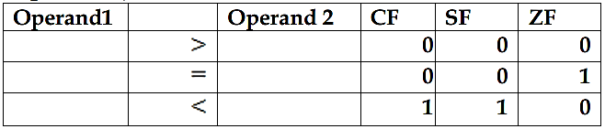
d) Comparison
CMP –compare
CMP reg/mem, reg/mem/immediate
E.g. CMP BH, AL

Slide 21
3) Data Transfer Instructions:
MOV reg./mem , reg./mem./immediate
LDS: Load data segment register
LEA: load effective address
LES: Load extra segment register
LSS: Load stack segment register
E.g. LEA BX, ARR = MOV BX, OFFSET ARR
LDS BX, NUM1
Segment address → DS
Offset address → BX
XCHG reg/mem, reg/mem
E.g. XCHG AX, BX
XCHG AL, BL
XCHG CL,[BX]
IN AL, DX ; DX: Port address, AH also in AL
OUT DX, AL/AH

Slide 22
4) Flag Operation
CLC: Clear carry flag
CLD: Clear direction flag
CLI: Clear interrupt flag
STC: Set Carry flag
STD: Set direction flag
STI: Set Interrupt flag
CMC: Complement Carry flag
LAHF: Load AH from flags (lower byte)
SAHF: Store AH to flags
PUSHF: Push flags into stack
POPF: Pop flags off stack

Slide 23
5) STACK Operations
PUSH reg16
POP reg16
6) Looping instruction (CX is automatically used as a counter)
LOOP: loop until complete
LOOPE: Loop while equal
LOOPNE: loop while not equal
LOOPZ: loop while zero
LOOPNZ: loop while not zero

Slide 24
7) Branching instruction a) Conditional
JA: Jump if Above
JAE: Jump if above/equal
JB: Jump if below
JBE: Jump if below/equal
JC: Jump if carry
JNC: Jump if no carry
JE: Jump if equal
JNE: Jump if no equal
JZ: Jump if zero
JNZ: Jump if no zero
JG: Jump if greater
JNG: Jump if no greater
JL: Jump if less
JNL: Jump if no less
JO: jump if overflow
JS: Jump if sign
JNS: Jump if no sign
JP: jump if plus
JPE: Jump if parity even
JNP: Jump if no parity
JPO: Jump if parity odd

Slide 25
b) Unconditional
CALL: call a procedure
RET: Return
INT: Interrupt
IRET: interrupt return
JMP: Unconditional Jump
RETN/RETF: Return near/Far

Slide 26
8) Type conversion
CBW: Convert byte to word
CWD: Convert word to double word
9) String instructions
a) MOVS/ MOVSB/MOVSW ; Move string
DS: SI source
DS: DI destination
CX: String length
b) CMPS/ CMPSB/CMPW ; Compare string
c) LODS /LODSB/LODW ; Load string
d) REP ; Repeat string

Slide 27
Operators in 8086
Operator can be applied in the operand which uses the immediate data/address.
Being active during assembling and no machine language code is generated.
Different types of operators are:
1) Arithmetic: + , - , * , /
2) Logical : AND, OR, XOR, NOT
3) SHL and SHR: Shift during assembly
4) [ ]: index
5) HIGH: returns higher byte of an expression
6) LOW: returns lower byte of an expression.
E.g. NUM EQU 1374 H
MOV AL HIGH Num ; ( [AL] 13 )

Slide 28
7) OFFSET: returns offset address of a variable
8) SEG: returns segment address of a variable
9) PTR: used with type specifications
BYTE, WORD, RWORD, DWORD, QWORD E.g. INC BYTE PTR [BX]
10) Segment override
MOV AH, ES: [BX]

Slide 29
11) LENGTH: returns the size of the referred variable
12) SIZE: returns length times type
E.g.: BYTE VAR DB?
WTABLE DW 10 DUP (?)
MOV AX, TYPE BYTEVAR ; AX = 0001H
MOV AX, TYPE WTABLE ; AX = 0002H
MOV CX, LENGTH WTABLE ; CX = 000AH
MOV CX, SIZE WTABLE ; CX = 0014H

Slide 30
Addressing modes in 8086:
Addressing modes describe types of operands and the way in which they are accessed for executing an instruction .
The basic modes of addressing are register, immediate and memory which are described below.
1) Register Addressing:
For this mode, a register may contain source operand, destination operand or both.
E.g.
MOV AH, BL
MOV DX, CX

Slide 31
2) Immediate Addressing
In this type of addressing, immediate data is a part of instruction, and appears in the form of successive byte or bytes. This mode contains a constant value or an expression.
E.g.
MOV AH, 35H
MOV BX, 7A25H

Slide 32
3) Direct memory addressing:
In this type of addressing mode, a 16-bit memory address (offset) is directly specified in the instruction as a part of it. One of the operand is the direct memory and other operand is the register.
E.g. ADD AX, [5000H]
Note: Here data resides in a memory location in the data segment, whose effective address may be computed using 5000H as the Offset address and content of DS as segment address. The effective address, here, is 10H*DS + 5000H

Slide 33
4) Direct offset addressing
In this addressing, a variation of direct addressing uses arithmetic operators to modify an address.
E.g.
ARR DB 15, 17, 18, 21
MOV AL, ARR [2] ; MOV AL, 18
ADD BH, ARR+3 ; ADD BH, 21
5) Indirect memory addressing:
Indirect addressing takes advantage of computer’s capability for segment: offset addressing. The registers used for this purpose are base register (BX and BP) and index register (DI and SI)
E.g.
MOV [BX], AL
ADD CX, [SI]

Slide 34
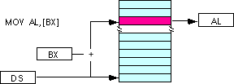
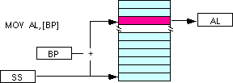

Slide 35
6) Base displacement addressing:
This addressing mode also uses base registers (BX and BP) and index register (SI and DI), but combined with a displacement (a number or offset value) to form an effective address.
E.g.
MOV BX, OFFSET ARR
=LEA BX, ARR
MOV AL, [BX +2]
ADD TBL [BX], CL
TBL [BX] -----> [BX + TBL] e.g. [BX + 4]

Slide 36
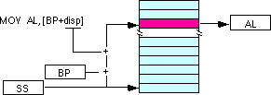
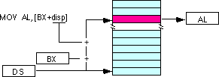

Slide 37
7) Base index addressing:
This addressing mode combines a base registers (BX or BP) with an index register (SI or DI) to form an effective address.
E.g.
MOV AX, [BX +SI]
ADD [BX+DI], CL
8) Base index with displacement addressing
This addressing mode, a variation on base- index combines a base register, an index register, and a displacement to form an effective address.
E.g.
MOV AL, [Bx+SI+2]
ADD TBL [BX +SI], CH

Slide 38
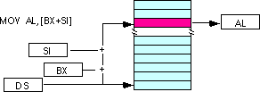
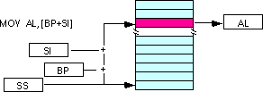

Slide 39
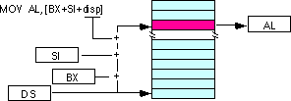
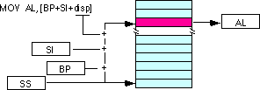

Slide 40
9) String addressing:
This mode uses index registers, where SI is used to point to the first byte or word of the source string and DI is used to point to the first byte or word of the destination string, when string instruction is executed. The SI or DI is automatically incremented or decremented to point to the next byte or word depending on the direction flag (DF).
E.g. MOVS, MOVSB, MOVSW

Slide 41
Coding in Assembly language
Assembly language programming language has taken its place in between the machine language (low level) and the high level language.
- High level language’s one statement may generate many machine instructions.
- Low level language consists of either binary or hexadecimal operation. One symbolic statement generates one machine level instructions.

Slide 42
Advantage of ALP
- They generate small and compact execution module.
- They have more control over hardware.
- They generate executable module and run faster.
Disadvantages of ALP:
- Machine dependent.
- Lengthy code
- Error prone (likely to generate errors).

Slide 43
Example
TITLE to display a string
.MODEL SMALL
.STACK 64
.DATA
STR DB ‘programming is fun’, ‘$’
.CODE
MAIN PROC FAR
MOV AX, @DATA
MOV DS, AX
MOV AH, 09H ;display string
LEA DX, STR
INT 21H
MOV AX, 4C00H
INT 21H
MAIN ENDP
END MAIN

Slide 44
Assembly language features:
Program comments:
The use of comments throughout a program can improve its clarity.
It starts with semicolon (;) and terminates with a new line.
E.g. ADD AX, BX ; Adds AX & BX
Reserved words:
Instructions : Such as MOV and ADD (operations to execute)
Directives: Such as END, SEGMENT (information to assembler)
Operators: Such as FAR, SIZE
Predefined symbols: such as @DATA, @ MODEL

Slide 45
Identifiers:
- An identifier (or symbol) is a name that applies to an item in the program that expects to reference.
- Two types of identifiers are Name and Label.
- Name refers to the address of a data item such as NUM1 DB 5, COUNT DB 0
- Label refers to the address of an instruction.
- E. g: MAIN PROC FAR
- L1: ADD BL, 73

Slide 46
Statements:
- ALP consists of a set of statements with two types
- Instructions, e. g. MOV, ADD
- Directives, e. g. define a data item
Directives:
The directives are the number of statements that enables us to control the way in which the source program assembles and lists.
These statements called directives act only during the assembly of program and generate no machine-executable code.
The different types of directives are:

Slide 47
1) The page and title listing directives:
The page directive defines the maximum number of lines to list as a page and the maximum number of characters as a line.
TITLE gives title and place the title on second line of each page of the program.
2) SEGMENT directive
It gives the start of a segment for stack, data and code.

Slide 48
3) PROC Directives
The code segment contains the executable code for a program, which consists of one or more procedures, defined initially with the PROC directives and ended with the ENDP directive.
PROC - name PROC [FAR/NEAR]
PROC - name ENDP
FAR is used for the first executing procedure and rest procedures call will be NEAR.
- Procedure should be within segment.

Slide 49
4) END Directive
- An END directive ends the entire program and appears as the last statement.
- ENDS directive ends a segment and ENDP directive ends a procedure. END PROC-Name

Slide 50
7) Dn Directive (Defining data types)
Assembly language has directives to define data syntax [name] Dn expression.
The Dn directive can be any one of the following:
DB Define byte 1 byte
DW Define word 2 bytes
DD Define double 4 bytes
DF defined farword 6 bytes
DQ Define quadword 8 bytes
DT Define 10 bytes 10 bytes

Slide 51
8) The EQU directive
- It can be used to assign a name to constants.
- E.g. FACTOR EQU 12
9) DUP Directive
- It can be used to initialize several locations to zero.
- e. g. SUM DW 4 DUP(0)

Slide 52
DOS FUNCTIONS AND INTERRUPTS
The common software interrupts used here are INT 10H for video services and INT 21H for DOS services.
INT 21H: It is called the DOS function call for keyboard operations follow the function number. The service functions are listed below:
# 02H- Display single character
Sends the characters in DL to display.
# 09H- string display
- Displays string until ‘$’ is reached.
- DX should have the address of the string to be displayed.

Slide 53
INT 10H
-It is called video display control.
-It controls the screen format, color, text style, making windows, scrolling etc.

Slide 54
Q2. Wap to display Hello World.

Slide 55
Wap to reverse given string for 8086.
.model small
org 100h
.data
String1 db 'assembly language program$'
Length dw $-String1-1
.code
Main proc
MOV AX, @data
MOV DS, AX
MOV SI, offset String1
MOV CX, Length
ADD SI, CX
Back: MOV DL, [SI]
MOV AH, 02H
INT 21H
DEC SI
LOOP Back
MOV AH, 4CH
INT 21H
Main endp
End Main

Slide 56
Wap to multiply two 16-bit numbers.

Slide 57
Wap to find the greatest number in a block of data.

Slide 58
Wap to count the number of vowels in a given string.

Slide 59
Assembling, Linking and Executing
1. Assembling:
Assembling converts source program into object program if syntactically correct and generates an intermediate .obj file or module.
Assembler converts assembly language into machine language.
Eg: TASM( Turbo assembler), MASM(Microsoft Assembler).
Assembler Types: There are two types of assemblers:
a) One pass assembler:
This assembler scans the assembly language program once and converts to object code at the same time.
This assembler has the program of defining forward reference i.e. a JUMP instruction using as address that appears later in the program must be defined by the programmer.

Slide 60
b) Two pass assembler
This type of assembler scans the assembly language twice.
First pass generates symbol table of names and labels used in the program and calculates their relative address.
This table can be seen at the end of the list file and here user need not define anything.
Second pass uses the table constructed in first pass and completes the object code creation.
No address calculations are needed to be done by the programmer for JUMP instruction.
This assembler is more efficient and easier than earlier.

Slide 61
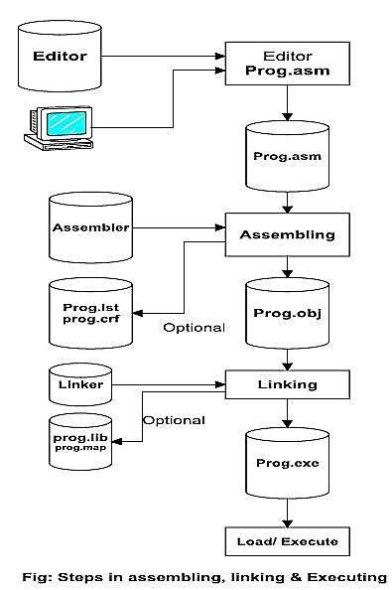

Slide 62
2) Linking:
This involves the converting of .OBJ module into .EXE(executable) module i.e. executable machine code
3) Loading and Executing:
- It Loads the program in memory for execution.
- It executes to generate the result.

Slide 63
Macro Assembler:
A macro is an instruction sequence that appears repeatedly in a program assigned with a specific name.
The macro assembler replaces a macro name with the appropriate instruction sequence each time it encounters a macro name.
When same instruction sequence is to be executed repeatedly, macro assemblers allow the macro name to be typed instead of all instructions provided the macro is defined.
Macro are useful for the following purposes:
To simplify and reduce the amount of repetitive coding.
To reduce errors caused by repetitive coding.
To make an assembly language program more readable.
Macro executes faster because there is no need to call and return.

Slide 64
Addition MACRO
IN AX, PORT
ADD AX, BX
OUT PORT, AX
ENDM

Slide 65
8085 vs 8086
Parameters | 8085 | 8086
Size | 8-bit | 16-bit
Address bus | 16-bit | 20-bit
Memory | 64KB | 1MB
Instruction queue | No | Has
Pipelining | No | Supports
I/O’s | 256 | 65536
Memory segmentation | No | segmented

